Slide 1
An Overview of the Windows HPC Server 2008R2
Required Slide
Boris Manitius
HPC Specialist Australia
Microsoft Corporation

Slide 2
Objectives and Takeaways
Session Objectives:
  Learn the basics of HPC industry & applications
  See what’s new with HPCS2008 R2
Key Takeaways
  Windows brings improved productivity and usability to IT Staff, developers, and end users
  Windows HPC Server 2008 R2 is taking high performance computing mainstream

Slide 3
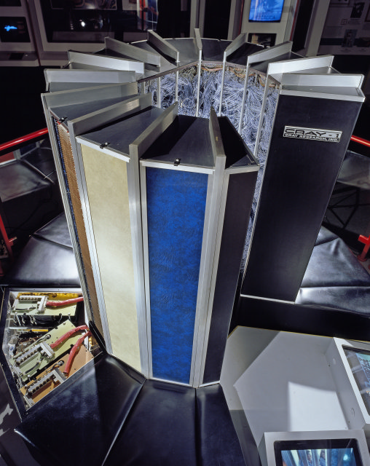









What is High Performance Computing?
A petaFLOP CPU and 10TB Memory
Or settle for 10,000 node clusters
Extremely high bandwidth, low latency
Solve large computational problems
Commonly associated with science
HPC also refers to high productivity
in recent years
1991
1998
2008
X64 Server
$40,000,000
$1,000,000
$1,000

Slide 4



Microsoft’s Vision for HPC
“Provide the platform, tools and broad ecosystem to reduce the complexity of HPC by making parallelism more accessible to address future computational needs.”
Reduced Complexity
Mainstream HPC
Developer Ecosystem
Ease deployment for
larger scale clusters
Address needs of traditional supercomputing
Increase number of parallel applications and codes
Simplify management for
clusters of all scale
Address emerging
cross-industry
computation trends
Offer choice of parallel development tools,
languages and libraries
Integrate with
existing infrastructure
Enable non-technical users to harness the power of HPC
Drive larger universe of developers and ISVs

Slide 5

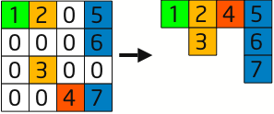
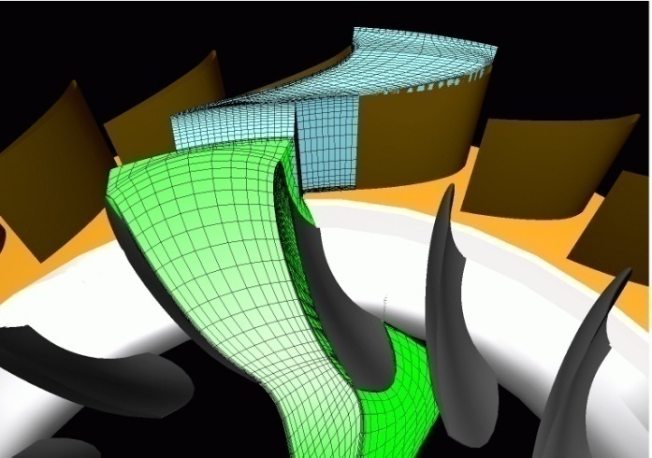

Application Scenarios
Classic Scenarios (MPI Model and tools)
  Oil & Gas
  Auto
  Aero
  EDU
  Gov
Newer Scenarios (SOA Model)
  Bio Informatics
  Pharma / Chemistry
  Digital Content creation
  Financial / Insurance

Slide 6
Product evolution
What we’ve heard from customers
Capabilities of R2
Release roadmap
Windows Server Operating System
2008 R2
Secure,
Reliable, Tested
Support for high performance hardware (x64, high-speed interconnects)
HPC Pack
Job Scheduler
Resource Manager
Cluster Management
Message Passing Interface
Microsoft Windows HPC Server 2008 R2
Integrated Solution
out-of-the-box
Leverages investment in Windows administration and tools
Makes cluster operation easy and secure as a single system
SDK

Slide 7

Product Evolution
http://www.flickr.com/photos/drachenspinne/212500261/

Slide 8




Microsoft Entry into HPC
2006
Personal Super Computing
Built on Windows Server 2003
Microsoft Entry into HPC
Addressing Personal And Workgroup Needs
End User Applications available for Windows
Parallel and HPC Development Tools
Ease of Management and Deployment

Slide 9





Windows HPC Server Today
2006
2008
Broad Reaching HPC
Built on Windows Server 2008
Support Traditional & Emerging HPC
Larger Cluster support & Top500 Range
Better integration for Windows-based Users
Broader Developer support with tools and SOA
Improved Management and Deployment

Slide 10




Windows HPC Tomorrow
2010
Parallel Extensions
2006
2008
2010
Highly Scalable, Highly Efficient HPC

Slide 11
What We’ve Heard From Customers
Flexible Deployment | We are now deploying diskless compute nodes I can’t upgrade my application to Windows Server 2008 R2 We want to get Windows running on my existing cluster
Extremes of Scale | Without great performance, we don’t even need to talk My business requires clusters of thousands of nodes We need to drop-ship small clusters around the world I can’t get my head around what’s happening on my cluster
Is Anything Wrong? | Help me check if my network is performing well How do I know if my application is configured properly What’s the progress of my job? I need to quickly figure out if the failure is from the user, application, system or network
Business Critical SOA | Provide each application a minimum number of cores Survive client and broker failures Support Java and Unix middleware clients
Excel on the Cluster | Speed up my Excel workbooks Expand use of the cluster to “non HPC users”
Notes:
Listening to Customer Feedback
Developer and User Experience

Slide 12

Flexible Deployment
http://www.flickr.com/photos/carowallis1/620967948/

Slide 13
Flexible Deployment
Customer Request | HPC Server 2008 R2 Features
Diskless Compute Nodes | iSCSI network boot = disk elsewhere Initial support for NetApp filers and Windows Storage Server 1000 nodes for University of Southampton Top 500

Slide 14
Deploying Diskless Compute Nodes
HPC head node
Remote Storage Array
(provides iSCSI Target)
DHCP
Base
Golden
Image
HPC
ISP
iSCSI Server Provider
CN
CN
CN
CN
Sysprep’d Golden Image
CN
CN
CN
CN
Differencing Disks
CN
CN
CN
CN
CN
CN
CN
CN
Diskless Compute Nodes
(iSCSI initiator)

Slide 15
Flexible Deployment
Customer Request | HPC Server 2008 R2 Features
Diskless Compute Nodes | iSCSI network boot = disk elsewhere Initial support for NetApp filers and Windows Storage Server 1000 nodes for University of Southampton Top 500
Upgrade Flexibility | Upgrade head node to R2 Server and HPC Pack Guidance on migrating history and configuration Compute nodes support Windows Server 2008 and 2008 R2
Database Performance | Split out data and log files at setup HPC Server databases on remote SQL Server

Slide 16
iSCSI boot resource
The documentation – step by step guide –
Web version of the guide on TechNet:
http://technet.microsoft.com/en-us/library/ee918811(WS.10).aspx
The DOC download of the guide on the Download Center:
http://www.microsoft.com/downloads/details.aspx?displaylang=en&FamilyID=737b7eca-d07e-4d24-8c98-68ebe5c66867

Slide 17

Extremes of Scale
http://www.flickr.com/photos/chrisdag/3706446455/in/set-72157600938800182/

Slide 18
Extremes of Scale
Customer Request | HPC Server 2008 R2 Features
Great performance | Performance equivalent to Linux Hands-on work with leading ISVs and open source codes Collaboration with Argonne on MPI Work with Open Fabrics Alliance for InfiniBand on Windows NetworkDirect for RDMA MPI communication

Slide 19
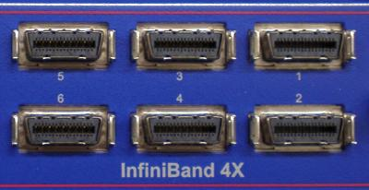
NetworkDirect
A new RDMA networking interface
built for speed and stability
Verbs-based design for close fit with native,
high-perf networking interfaces
Equal to Hardware-Optimized stacks for MPI
micro-benchmarks
NetworkDirect drivers for
key high-performance fabrics:
  InfiniBand [available now!]
  10 Gigabit Ethernet
  (iWARP-enabled) [available now!]
  Myrinet [available soon]
MS-MPIv2 has 4 networking paths:
  Shared Memory between processors
  on a motherboard
  TCP/IP Stack (“normal” Ethernet)
  Winsock Direct for sockets-based RDMA
  New NetworkDirect interface
Socket-Based App
MPI App
MS-MPI
Windows Sockets
(Winsock + WSD)
RDMA Networking
Networking Hardware
Networking Hardware
WinSock Direct Provider
Networking Hardware
Networking Hardware
TCP/Ethernet
Networking
NetworkDirect Provider
Networking Hardware
Networking Hardware
User Mode
User Mode Access Layer
TCP
Kernel Mode
IP
NDIS
Kernel By-Pass
Networking Hardware
Networking Hardware
Mini-port Driver
Networking Hardware
Networking Hardware
Hardware Driver
Networking Hardware
Networking Hardware
Networking Hardware
(ISV) App
HPCS2008 Component
OS Component
IHV Component

Slide 20
High performance on standard benchmarks
Memory throughput performance on Intel Xeon® Processor X5550:
    Function Rate (MB/s)
    Copy: 38710.5347
    Scale: 38722.8032
    Add: 37164.4369
    Triad: 37180.2195
MPI PingPong Bandwidth on a QDR IB fabric: ~3GB/s**
MPI PingPong Latency on a QDR IB fabric: Under 2us**
HPL results from www.top500.org:
Memory Throughput (Measured by
Stream Triad, in GB/s)*
Site | Umea University | University of Stuttgart | NCSA | Shanghai SC
Rmax (Tflops) | 46 | 50.7 | 68.4 | 180
Efficiency | 85.64% | 84.35% | 76.44% | 77.35%
Results are based on STREAM benchmark (http://www.cs.virginia.edu/stream).
Windows Benchmarks quoted from http://blogs.technet.com/eec/archive/2009/07/15/3264921.aspx.
Linux data quoted from http://www.advancedclustering.com/company-blog/stream-benchmarking.html.
** Measured with Windows HPC Server 2008 MPI Diagnostics. Through a single switch, additional switch hop may reduce the network throughput and increase the network latency.

Slide 21
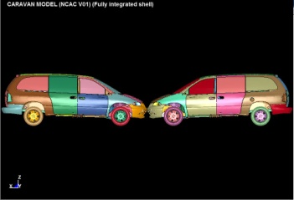
Windows Matches Linux Performance on LSTC LS-DYNA®
Reference: Dataset is car2car, public benchmark. LSTC LS-DYNA data to be posted at http://www.topcrunch.org
LS-DYNA version mpp971.R3.2.1. Similar hardware configuration was used for both Windows HPC Server 2008 and Linux runs:
Windows HPC: 2.66GHz Intel® Xeon® Processor X5550, 24GB DDR3 memory per node, QDR InfiniBand
Linux: 2.8GHz Intel® Xeon® Processor X5560, 18GB DDR3 memory per node, QDR InfiniBand
Courtesy of LSTC

Slide 22
Extremes of Scale
Customer Request | HPC Server 2008 R2 Features
Great performance | Performance equivalent to Linux Hands-on work with leading ISVs and open source codes Collaboration with Argonne on MPI Work with Open Fabrics Alliance for InfiniBand on Windows NetworkDirect for RDMA MPI communication
Demonstrate scalability | System designed with failure in mind Regular testing on 1000+ node clusters Guidance on head node configurations Regular Top 500 runs

Slide 23
Extremes of Scale
Customer Request | HPC Server 2008 R2 Features
Great performance | Performance equivalent to Linux Hands-on work with leading ISVs and open source codes Collaboration with Argonne on MPI Work with Open Fabrics Alliance for InfiniBand on Windows NetworkDirect for RDMA MPI communication
Demonstrate scalability | System designed with failure in mind Regular testing on 1000+ node clusters Guidance on head node configurations Regular Top 500 runs
Usability for both large and small clusters | Heat map and node list view customization Location-based node groups PowerShell scripting for all actions Integration and consistency with Windows Server Extensibility with Microsoft Operations Manager

Slide 24
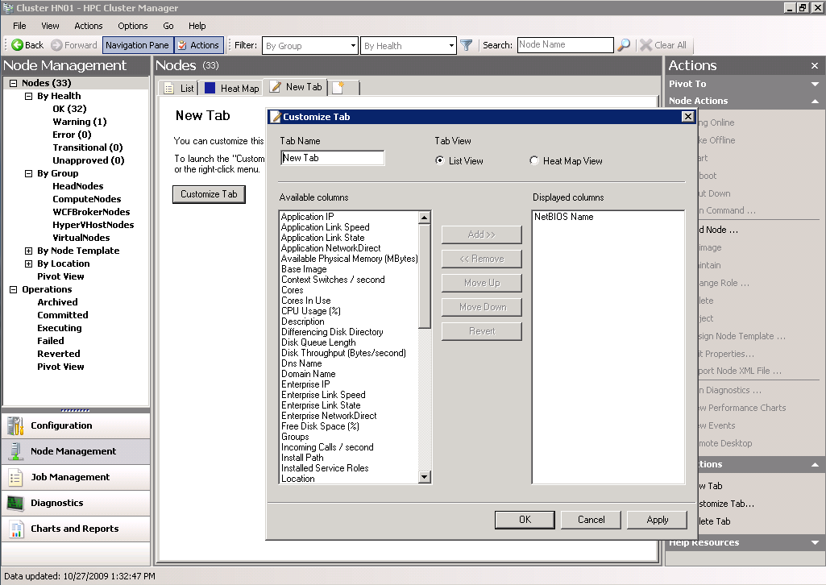
Customize Your Console

Slide 25
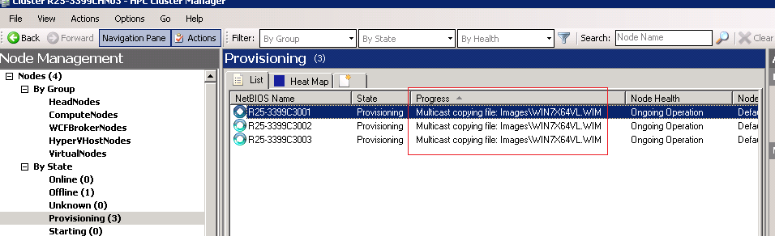
Deployment Progress at a Glance
Notes:
New column in the node management pane – “progress”.
Sort on the column to detect the outliers.
Drill down into the provisioning logs for more details.

Slide 26
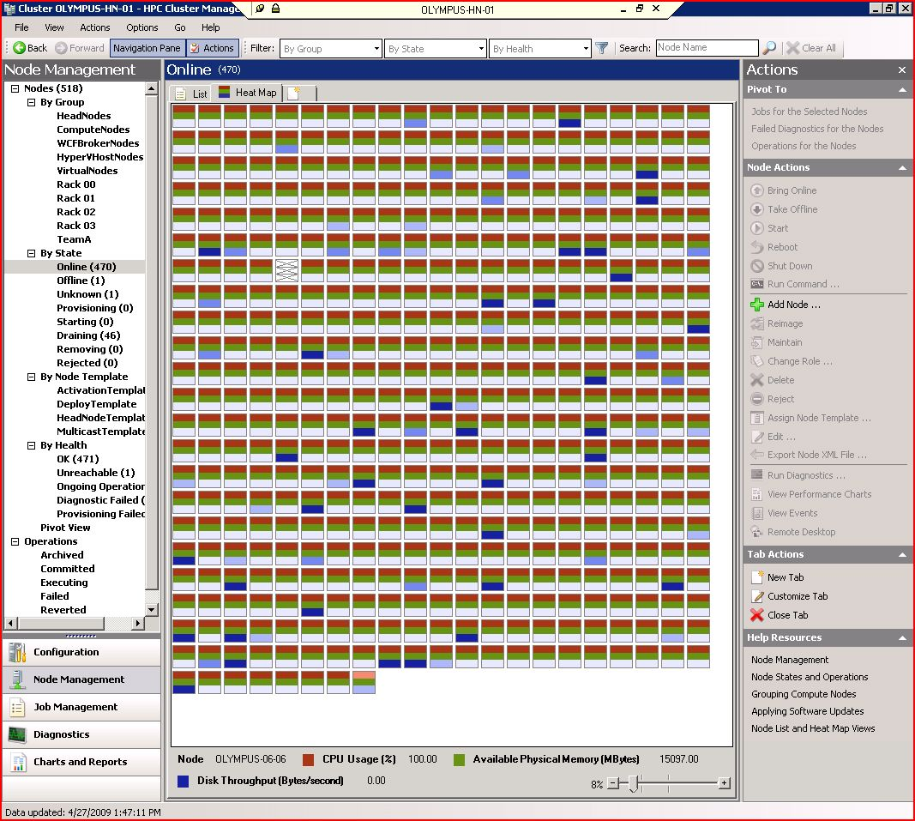
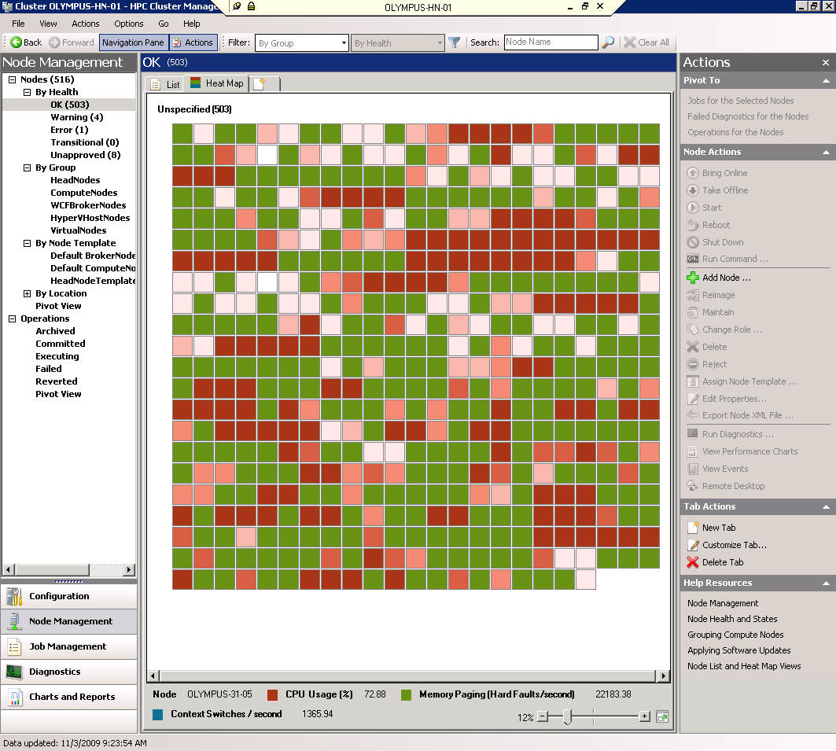
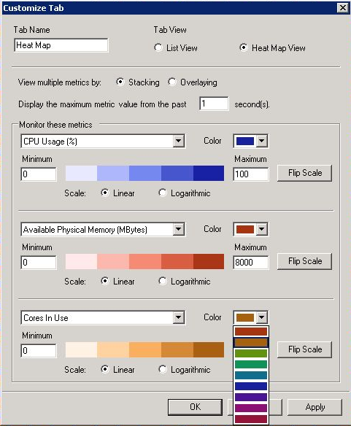
Flexible Heat Map
Notes:
Support for larger node counts
Overlay or Stack views
Zoom In/Out
Filtering by Group, State, & Health
Custom Tabs or “Familiar List”
Ability to customize Further…
Overlay or stacking
Max over interval
Flip Scale
Log scale
Colors

Slide 27

Is Anything Wrong?
http://www.flickr.com/photos/mandyxclear/3461234232

Slide 28
Is Anything Wrong?
Customer Request | HPC Server 2008 R2 Features
Diagnostics Framework | Extensible diagnostics framework Write your tests in script or code We’re working with ISVs, networking vendors, and OEMs New diagnostics coming for SOA and networking

Slide 29
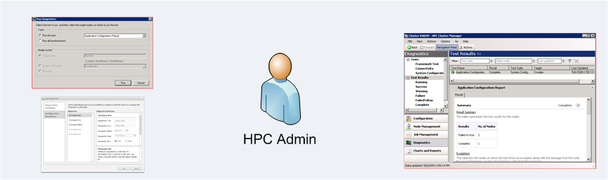
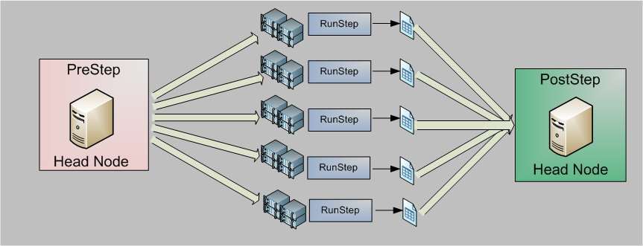
Extensible Diagnostic Framework
Each step is a command line for integration with tests written in any language.
Notes:
PRE
Performs validation; prepares environment
Example: Excel validation test only runs on nodes with App A installed. PreStep removes nodes without App A from selected nodes list
RUN
Test execution
Run once on each compute node requested
Stdout and stderror are saved on head node
POST
Aggregate and analyze results, prepare for display
Performs automated admin actions
Example: In node health test, admin automates taking failed nodes offline in PostStep

Slide 30
Is Anything Wrong?
Customer Request | HPC Server 2008 R2 Features
Diagnostics Framework | Extensible diagnostics framework Write your tests in script or code We’re working with ISVs, networking vendors, and OEMs New diagnostics coming for SOA and networking
Job Progress | Job progress dialog to show % done New API for applications to report custom status Task status and error rollup

Slide 31
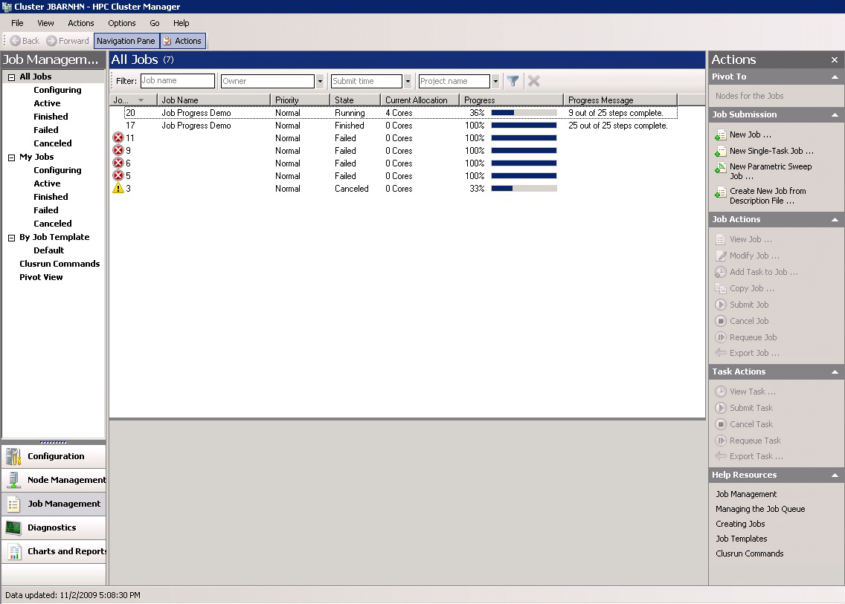
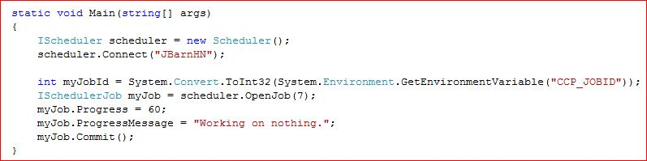
View Job and Task Progress

Slide 32
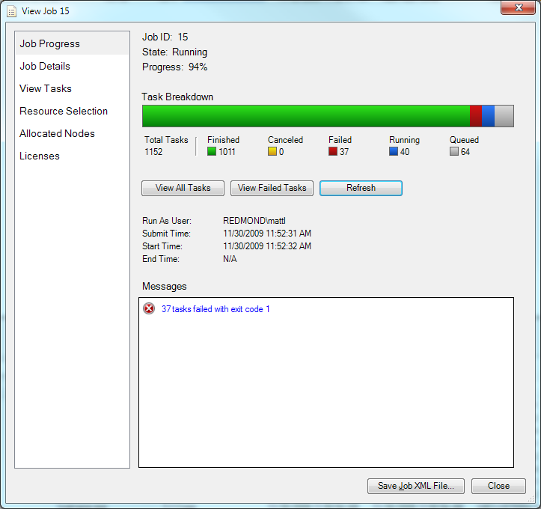
View Job and Task Progress

Slide 33
Is Anything Wrong?
Customer Request | HPC Server 2008 R2 Features
Diagnostics Framework | Extensible diagnostics framework Write your tests in script or code We’re working with ISVs, networking vendors, and OEMs New diagnostics coming for SOA and networking
Job Progress | Job progress dialog to show % done New API for applications to report custom status Task status and error rollup
Errors and Tracing | Review of all error messages Deployment sub-status SOA tracing MPI and SOA debugging

Slide 34
Is Anything Wrong?
Customer Request | HPC Server 2008 R2 Features
Diagnostics Framework | Extensible diagnostics framework Write your tests in script or code We’re working with ISVs, networking vendors, and OEMs New diagnostics coming for SOA and networking
Job Progress | Job progress dialog to show % done New API for applications to report custom status Task status and error rollup
Errors and Tracing | Review of all error messages Deployment sub-status SOA tracing MPI and SOA debbuging
Database Extensibility | Export job and task history for custom reporting Analysis with SQL Server Reporting, Excel, etc.

Slide 35
HPC Cloudbursting with Azure

Slide 36




Windows HPC Server 2008 R2
Complete, integrated HPC stack for all* parallel cluster applications:
HPC Clients
Compute Nodes
Head & Broker Nodes
Jobs
Requests
* All: MPI, SOA, Batch, Interactive, Parametric sweeps. …

Slide 37

HPC on Windows Azure
Use Windows Azure as compute nodes to run Windows HPC Server Jobs (unchanged)
HPC Clients
Azure
Head & Broker Nodes
Jobs
Requests
Azure Gateway

Slide 38
HPC on Azure: The Cloud on your terms
Four Deployment Models
All on premise
All the compute nodes are on premise
All in the cloud
All the HPC compute nodes are in Azure
Mix it up
Compute nodes on premise and cloud Change dynamically
Switch Back
Move back from Cloud to on-premise.
Two Storage Models
Two Application Models
Store Data on-premise, access from Azure.
Store Data in Azure: SQL Azure, Azure Storage
As a Cluster SOA service – Deploy as Azure Worker Role.
Any supported Azure app – Deploy as a Virtual Machine

Slide 39


All On-Premise
Head & Compute nodes run in your data center
On-premise
Benefits of cloud elasticity while keeping control of data and IT.
Can be used to create a private cloud.
Maximize cluster utilization
Stepping stone to public clouds
Desktop
Desktop
Desktop
HPC Head Node
Compute Nodes

Slide 40

Mixed Mode: On-premise and Azure
Compute nodes on-premise and in Azure simultaneously
On-premise
Desktops
“Burst” into cloud on-demand while keeping control over data and corporate policies
Pay only for what you use
A stepping stone to hybrid and public clouds.
Dynamically adjust how much runs on-premise and in the cloud
HPC Head Node
Broker Node
Compute Nodes
Azure
Worker/Web Role
RDB
Worker/Web Role
Blobs
Worker/Web Role

Slide 41

All in the cloud
Head & Compute nodes in Azure
Azure
Run HPC jobs without managing or maintaining a cluster
Guaranteed SLAs
Pay as you go, only for what you use
Worker/Web Role
RDB
HPC Head Node
Worker/Web Role
Blobs
HPC VM

Slide 42
HPC on Azure - Benefits
Flexibility and Choice
The cloud on your terms:
Choice of deployment models (on-premise, cloud or mixed mode)
Choice of application models (managed or VM based)
Choice of storage models (SQL, Storage or local)
Deep integration with Azure
Technically integrated with Azure programming, deployment and management models.
Single, unified view of resource utilization and costs.
Single comprehensive solution from one vendor
Only way to offer guaranteed performance and availability SLAs.
Single point of contact for support.
End-to-end integration for ease of diagnostics, debugging and monitoring
Familiar Development Tools and Runtime
Use the familiar, proven tools & runtime for all deployment models:
Visual Studio
Cluster SOA and MPI
Cluster profiler and debugger
HPC Cluster Manager

Slide 43

Business Critical SOA
http://www.flickr.com/photos/richardsummers/269503660/

Slide 44
Business Critical SOA
Customer Request | HPC Server 2008 R2 Features
Conveniently Parallel Applications | Expose calculations as WCF services Scale out business applications to a cluster High throughput and low latency

Slide 45

Cluster SOA Architecture
Head Node
Compute Nodes
1. Create Session
2. Session Manager starts WCF Broker Instance
3. Requests
4. Requests
Workstation
WCF Broker Nodes
6. Responses
5. Responses

Slide 46
Business Critical SOA
Customer Request | HPC Server 2008 R2 Features
Conveniently Parallel Applications | Expose calculations as WCF services Scale out business applications to a cluster High throughput and low latency
Fire and Recollect | Client submits requests and returns for results SOA batch paradigm Request and results survive client failures
WS-* Interop | Built on Web Service standards Samples for Java and C/C++ middleware clients

Slide 47
Supporting Disconnected Clients
Broker
Node
Broker Service
SOA Client
Broker
Compute Node
Store
Get
Broker Node
list
Head Node
Session Handler
Http or Net.Tcp

Slide 48
Business Critical SOA
Customer Request | HPC Server 2008 R2 Features
Conveniently Parallel Applications | Expose calculations as WCF services Scale out business applications to a cluster High throughput and low latency
Fire and Recollect | Client submits requests and returns for results SOA batch paradigm Request and results survive client failures
WS-* Interop | Built on Web Service standards Samples for Java and C/C++ middleware clients
Broker Failover | HA broker deployment with Windows Failover Services MSMQ used to persist requests and responses

Slide 49
Automated Broker Failover
Any broker can take-over a session
N + 1 reliability
Load Sharing
Established MSMQ HA practice
Leverage existing management tools for MSMQ
Stateless Broker Nodes\MSCS Storage
Broker Node
MSCS Cluster
Brokers
Queues
Shared Storage

Slide 50
Business Critical SOA
Customer Request | HPC Server 2008 R2 Features
Conveniently Parallel Applications | Expose calculations as WCF services Scale out business applications to a cluster High throughput and low latency
File and Recollect | Client submits requests and returns for results SOA batch paradigm Request and results survive client failures
WS-* Interop | Built on Web Service standards Samples for Java and C/C++ middleware clients
Broker Failover | HA broker deployment with Windows Failover Services MSMQ used to persist requests and responses
Service Balanced Scheduling | Control applications “interactively” Guarantee applications minimum number of cores Grow and shrink with available resources

Slide 51
Service Balanced Scheduling
Single, regular priority
job runs using all nodes
Second job added with
equal priority
Third job added
but with lower
priority
“My cluster runs a number of services, and I want it to dynamically provide resources
to the services that need them most.”

Slide 52
SOA vs. Parametric Tasks
SOA Messages | Parametric Tasks
Typed Messages (.NET classes) | Command lines with input/output files
Multiple workitems per process | One workitem per process
Persistent and non-persistent queues | Persistent queue
Scaled out queues | One queue

Slide 53

Excel on the Cluster
http://www.flickr.com/photos/mvjaf/2209185558/

Slide 54

Customer Requirement
Problem: Time is money
Customers want results, now! And/or
Customers want the ability to run more calculations
Windows HPC Server can dramatically reduce the desktop run-time of Excel calculations; provide a way to compute more at once; limited by available compute resources
Notes:
With Windows HPC Server 2008 R2, we promise you the ability to do more in less time.

Slide 55
HPC Services for Excel 2010
Connects to the cluster as a SOA client
VSTO code in workbook calls out to SOA Service
Input and output managed by Excel developer
Run multiple instances of Excel 2010 on an HPC Cluster
Each instance runs an iteration of the same workbook
Can be launched from Excel 2010 or a Windows program
Excel Dialog Suppression
Windows HPC Server 2008 R2 Provides two new mechanisms to distribute Excel calculations to an HPC Cluster
Run User Defined Functions in parallel on a cluster
Excel 2010 includes a new API and options for HPC cluster
Support for .XLL files developed through Excel SDK
Easy to develop on a desktop and deploy to a cluster
Excel SOA Client
Excel workbooks on the Cluster
NEW
Excel UDF on the Cluster
NEW
Notes:
How do we do this? We provide 2 new ways for Excel to talk to an HPC Server

Slide 56

Sample Models and Markets
Financial
Trade re-pricing
Overnight/cross-market
Est. 4 hours for a subset of trades
HPC Solution
Subset of trades in ~5 minutes
Insurance
Reserve requirements calculation
Data sets from 1000’s to 1 million
4 weeks to calculate (on a monthly schedule)
HPC solution:
Full calculation in 24 hours
Notes:
Two use cases that demonstrate the dramatic reduction in run time.

Slide 57
Cluster-Enabled UDFs
Discrete calculations modeled in a function
  User-defined Function (UDF)
Calculation is complex or time-consuming
Calculation is independent of other cells
The function changes infrequently

Slide 58
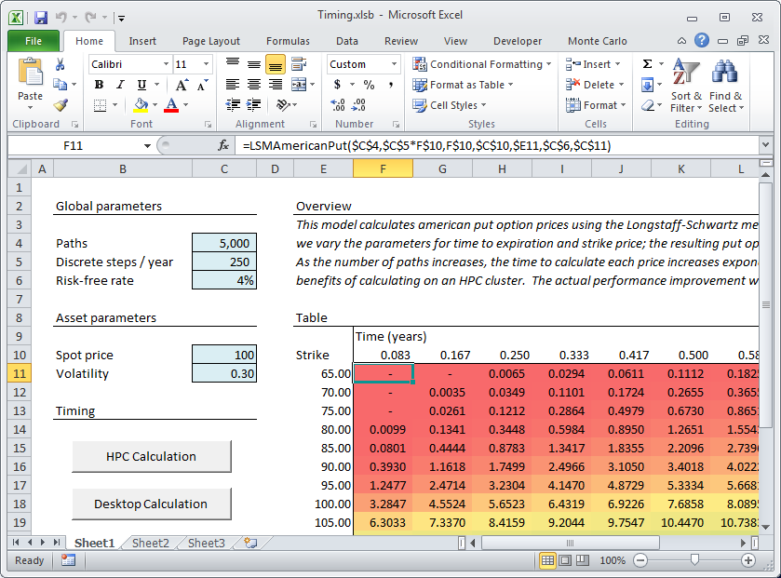
UDF Illustration
Function is self-contained, e.g. no workbook callbacks
Notes:
This is a sample worksheet where in each cell lives a self contained UDF

Slide 59

UDF Offload Architecture
Broker Node
HPC
Broker
Client Node
Excel 2010
Compute Node
UDF Container
MyUDF.XLL
UDF
Connector
MyUDF.XLL
Notes:
MyUDF.xll in the last sample was the LSMAmericanPut()
Client
Install Excel 2010
HPC client components - Connector
Install .xll file(s) – Excel Extension Files
Start Excel
Load Workbook with UDF references
Configure Cluster Name & Template
Calculate
Head Node
Broker Service Registration File
Compute Node
HPC Components – Container
.xll in path, XLLPATH

Slide 60
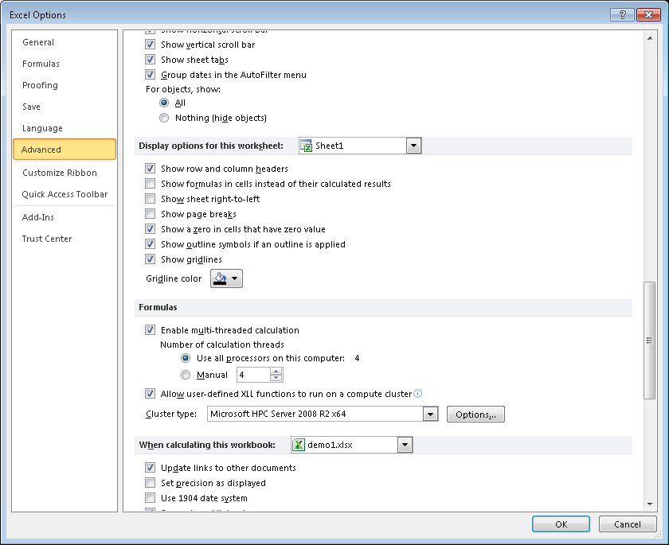
Notes:
Since this is available out of the box, once the HPC client utilities are installed, a user can offload their UDF by simply enabling the option
Here, you Configure Cluster Name & Template

Slide 61
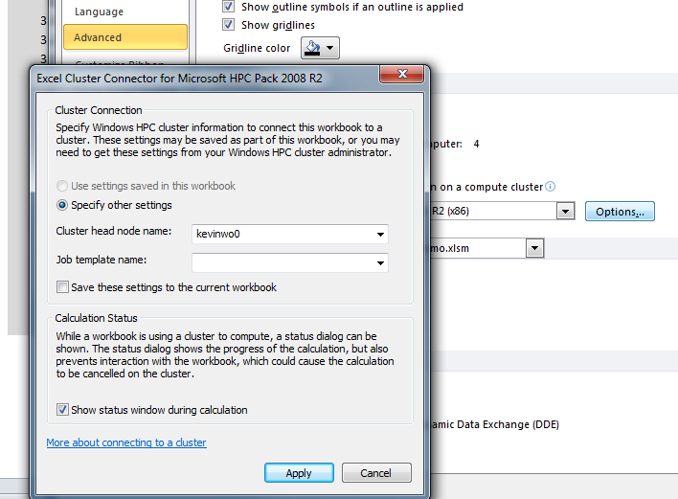
What’s New in The Release Candidate
Status Window
Notes:
Here, you Configure Cluster Name & Template

Slide 62
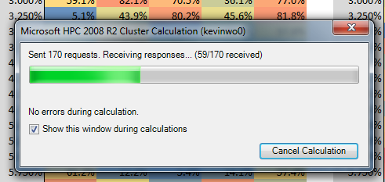
What’s New in The Release Candidate
Status Window

Slide 63
Development
Use Excel SDK to develop “myudf.xll”
Asynchronous C++ API
Limitations on the API
  Can’t call back into the worksheet
  Parameters are call by value
  Excel standard data type: XLOPER12
  Asynchronous functions
Mark .xll as “cluster safe” (similar to thread safe)
  Add a “&” to parameters in the registration function in the .xll in xlfRegister()

Slide 64
Cluster-Enabled UDFs Strengths & Weaknesses
Strengths
Parallelizable calculations
Improved performance
Enable/disable cluster use
Re-use existing UDFs
Weaknesses
Limitations on functions: subset of Excel API
Cluster overhead
Requires recompilation
Develop in C/C++
Limitation processing 10’s of thousands of quick running UDFs
Notes:
Processes can slow down with 10’s of thousands of UDFs running, particularly if the UDFs are not long running unto themselves.

Slide 65
Workbook Offloading
Offload entire workbook to the cluster for calculation
Partition workbook calculation

Slide 66
Use Cases
Great for parametric sweep applications such as Monte Carlo simulations where data can be partitioned
  Calculations are iterative
Potential wherever Excel is used as the calculation engine and not simply as a data collection interface
Where calculations may be re-run frequently with minor data changes
Desire to significantly improve execution times for workbooks

Slide 67
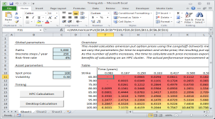
HPC Workbook Calculation
HPC Cluster
Notes:
Supports Excel calculation, VBA, Add-ins
Outside resources: databases, files, dependent workbooks
Same workbook on the cluster & the desktop
Supports capturing and dismissing pop-ups

Slide 68





Programming Model
Network Share
Excel 2010
Excel Workbook
HPC/Excel Add-in
Macros
Network Resources
VBA Driver
WCF Broker
Nodes
Excel 2010
HPC/Excel Client
Excel Driver
Excel Driver
.NET / COM
HPC/Excel Service
Applications
CLI
R2
R2
R2
Desktop Client
Windows HPC Cluster
Notes:
Programming Model
VBA development
Application development API
Service development API

Slide 69
Built-in client and service tools
Macro framework functions:
  Get Version*
  Initialize*
  Partition*
  Execute
  Merge*
  Finalize*
Single workbook includes both desktop and cluster calculation functions
* new macros since Beta 1

Slide 70
Built-in client and service tools
Get Version
Initialize
Partition
Execute
Merge
Finalize
Notes:
Get Version validates the version attempting to be run to be sure it is supported…this was added for backwards compatibility as we develop future versions.
HPC_Initialize copies a workbook to a specified network share.
The HPC_Partition macro is designed to subdivide the calculation into individual steps, so we can send those steps one at a time to the cluster for calculation.
This macro does two important things: first, it collects the data necessary for any individual calculation step. Any data we need for a single calculation will be passed as the return value of this function.
Second, this macro controls execution. When the calculation is complete, the macro should return Null – that tells the HPC library that there are no more calculation steps.
The HPC_Execute function actually runs a single step in the calculation. It’s important to understand that this function – this macro, unlike the other macros – runs on the cluster compute nodes. When the HPC calculation runs, the library will copy the whole workbook to the HPC cluster. On cluster compute nodes, Excel will start and load the workbook; then it will call the HPC_Execute macro.
The third key macro is HPC_Merge. This macro runs on the desktop, collects the results of the calculation from the HPC_Execute macro, and processes them on the desktop.

Slide 71
Built-in client and service tools
Desktop
HPC Cluster
Save temporary copy of workbook
Start Excel and Load Workbook
Send Requests until Null Response
Partition
Execute
Merge
Receive Responses until Error or Finished

Slide 72
Original VBA Code
Iterative loop calculation
Function RunModel()
' set up variables
NumIterations = Range("C8").Value
' run calculation in a loop
For n = 1 To NumIterations
rslt = CalculateSingleIteration(n)
ConsolidateResults rslt
Next n
' complete
call UpdateCharts
End Function

Slide 73
Modified VBA Code
Business logic is moved, but unchanged
Function Execute( data As Variant ) As Variant
' run single iteration
Execute = CalculateSingleIteration(data)
End Function
Function Merge( data As Variant )
' insert results into workbook
ConsolidateResults data
End Function
Notes:
The parameters (or inputs) to the HPC_Execute macro are whatever we returned from the HPC_Partition macro. That’s why it’s important to collect all necessary information in that macro, and return it – when HPC_Execute is called on the compute node, it doesn’t know anything about the workbook except what it gets sent via the parameters.
HPC_Execute can return any data – there’s a single return value, but you can return an Array of values so you can return a large amount of data if you want. Remember that this macro is running on the compute node. Any information we want to preserve – the results of the calculation and anything else – must be passed as the return value of the function. Everything else – the cells in the workbook, global variables, and so on – will be lost, because the macro is running on a cluster compute node. That means whatever information you want to preserve from the calculation must be returned from the function.

Slide 74
Workbook Offload Strengths & Weaknesses
Strengths
Parallel calculation
Performance
Multiple programming models
VBA developers
Scripting/Applications
Does not require Excel on the Compute Node
Weaknesses
Requires workbook development
Manual partitioning
Only improves iterative calculations

Slide 75
What’s New in The Release Candidate
A more robust API
  Get Version, Initialize, Join-Fork macro, Finalize
Performance tuning
Expanded tracing on the cluster and locally
Improved error handling and logging
Additional diagnostics
Notes:
Example of changes:
RemoteWorkbookPath moved from Initialize to OpenSession (both COM and .NET) – this results in some parameter reordering
The COM OpenSession now takes Job template and service name as optional parameters
The COM OpenSession now treats the number of resources and type of resources (core/node/socket) as optional
Removed DeployWorkbook from ExcelClient API
Microsoft.Hpc.Excel.WorkItem.GetAll now returns an object[] rather than a list<object> to comply with FxCop

Slide 76
In-House Stress and Scale Results
Excel 2010 64 bit
  Up to 5000 cores
  8 cores/node
  100,000 calcs/wb;
  total calcs executed: 299,600,000 in 288 hours (12d)
    That’s 1 million calcs per hour or
    ~17k calcs per minute

Slide 77
Absolute Performance
Pricing model: 250 assets
Includes Excel calculation, VBA, and external libraries
On the desktop: more than one hour
On a 64-core cluster: 65 seconds

Slide 78
Performance Considerations
Overhead
  Fixed overhead, variable overhead
  Cold start vs. warm start
  Network latency
Cluster Utilization
  Other running computations
  Effective parallelization
Observed Performance
  Comparative performance vs. desktop (Real-world usage)
  Hardware factors, scalability

Slide 79
Decision Framework
When is HPC Services for Excel 2010 the appropriate solution?
Optimally: Write applications in native code
Or use Excel:
Support legacy code & legacy models
Usability and user familiarity
Development skills: VBA vs. code development

Slide 80
Decision Framework
Which framework should I use?
Cluster-enabled UDFs
Fast execution of single, atomic calculations
Development skills required

Slide 81
Decision Framework
Which framework should I use?
HPC Workbook Calculation
Flexible development in VBA or using the API
Robust programming model
Supports business users & VBA developers
Requires developer analysis and modification of models

Slide 82
Decision Framework
Which framework should I use?
Let the problem dictate the solution.
The key to HPC Services for Excel 2010 is that it fits into existing user workflow. Don’t make users change their behavior – just give them better performance.

Slide 83
Requirements
Client
Excel 2010, 64 or 32-bit
Windows 7
Windows Vista
Windows XP (32-bit only)
Cluster
Windows HPC Server 2008 R2
Excel 2010 (workbook offload, only)

Slide 84
Resources
Documentation
Under ‘Featured Content’ on TechNet.
On the Download center
  Building VBA applications
  Building a custom client and service
  Building a .Net application
  Converting cluster-safe UDFs for Offloading
HPC V3 Released! Microsoft Connect to download

Slide 85
Release Schedule
Q2 2009
Q3 2009
Q4 2009
Q1 2010
Summer 2010
May
June
July
Aug
Sept
Oct
Nov
Dec
Jan
Feb
Mar
Community Technical Preview
May 2009
CTP 2
Sept 2009
Beta 1
Nov 2009
Beta 2
Mar 2010
RTM
Summer 2010
Windows HPC Server 2008 SP1
Address early
adopter feedback
RTM Summer 2010
English, Chinese, Japanese

Slide 86
HPC Server 2008 R2 Highlights
Flexible Deployment | Diskless compute nodes with iSCSI boot
Extremes of Scale | Demonstrated performance and scalability
Extensible Diagnostics | Diagnostics framework and new tests
Business Critical SOA | Disconnected clients and broker failover
Excel on the Cluster | Distributed Excel and UDF offloading
Cluster of Workstations | Allow Workstations to join the cluster

Slide 87
HPC Server 2008 R2 Summary
Flexible Deployment | Diskless compute nodes Upgrade flexibility Database performance Dual boot clusters
Extremes of Scale | Equivalent performance Demonstrate scalability Usability at both extremes
Extensible Diagnostics | Diagnostics framework Job progress Database extensibility Errors and tracing
Business Critical SOA | Conveniently parallel applications Service balanced scheduling File and recollect Broker failover WS-* interop
Excel on the Cluster | Excel SOA client Excel runner UDF on the cluster

Slide 88
More Information
http://www.microsoft.com/hpc
http://blogs.msdn.com/hpctrekker
http://channel9.msdn.com/shows/The+HPC+Show
http://www.kitware.com/
http://technet.microsoft.com/en-us/hpc/default.aspx

